Slide 1
Crafting Compelling Web Presences Project
Guvi Digital Marketing Landing Page
A EBI
MBE5
ebichan4321@gmail.com

Slide 2
GUVI DIGITAL MARKETING
Introduction:
Welcome to the presentation of "Crafting Compiled Web Presence." As a digital marketing intern, I embarked on a journey to establish a strong online presence for GUVI Digital Marketing.
This project encapsulates my dedication to honing my skills in various facets of digital marketing, including social marketing, email marketing, video marketing, and SEO.
I aimed to offer a comprehensive internship program that encompasses these essential areas, each meticulously tailored to provide valuable insights and hands-on experience.

Slide 3
Project Scope
Description:
The GUVI Digital Marketing website serves as a comprehensive platform designed to showcase our expertise and offerings in the realm of digital marketing. With the domain guvimbe.liveblog365.com, My aim is to establish a strong online presence and provide valuable resources for Students seeking to enhance their digital marketing strategies.

Slide 4
Key Components
Profreehost: Host is providing a free domain for my website.
WordPress Platform: The website is built using WordPress, offering flexibility, scalability, and ease of management.
Elementor Plugins: To enhance the visual appeal and functionality of the website, incorporate Elementor plugins. Header and Footer also designed by this plugins.
Astra Themes: Utilizing Astra themes, we ensure a modern and responsive design that is optimized for various devices and screen sizes.
Contact Form 7: Provide a user-friendly contact form, allowing visitors to reach out to us easily.

Slide 5
Internship Offerings
Email Marketing
Video Marketing
Social Media Marketing
SEO
Description of each internship offerings, Importance of each area in digital marketing strategy

Slide 6
Findings & Recommedations
Assessment of the website's performance
User engagement metrics
Traffic sources and trends
Strengths and weaknesses identified
Suggestions for improvement
SEO optimization strategies
Content enhancement ideas
User experience enhancements

Slide 7
Keypoints Highlightings
Mobile Responsiveness:
In today's mobile-centric world, having a responsive website is crucial.
A mobile-friendly design ensures a seamless user experience across various devices and improves search engine rankings.
Measurable Results:
Tools like Google Analytics enable you to track and measure the performance of your website
24/7 Accessibility:
Unlike traditional stores, a website is accessible round the clock, allowing customers to engage and make purchases at their convenience.
Enhanced Visibility:
Implementing SEO strategies drives organic traffic and increases brand visibility.

Slide 8
Target Audience
Target audience comprises businesses, entrepreneurs, students, and professionals seeking to enhance their digital marketing knowledge and skills. Whether you're a novice exploring the fundamentals of digital marketing or an experienced practitioner looking to stay updated on the latest trends, GUVI Digital Marketing caters to diverse needs and interests.

Slide 9
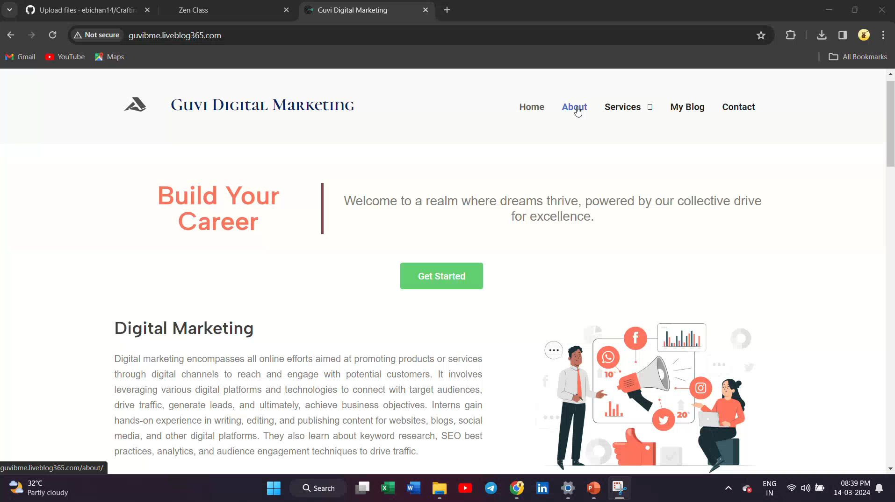
PROJECT PREVIEW

Slide 10
Conclusion
The Guvi Digital Marketing website serves a dynamic and informative hub. With its comprehensive offerings, user-friendly interface, and commitment to excellence, it stands as a testament. This project guide me to how to create profreehost to provide a domain on the website. I have created a website that is easily accessible to everyone.

